Slide 1
Sales Analysis
Mohamed Batran

Slide 2

Agenda
Introduction
Define The Data
Analysis Tools
Analysis Output
Summary

Slide 3

Introduction
This Presentation is about analytics for Sales dataset
Our goals of these analytics is discovering a lot of important insights and information that will help us for Business Growth and to reach to criteria to increase our sales using methods and patterns , and this we will achieve it by accurate analysis ,so this is my mission.

Slide 4
Define The Data
So, Our dataset has 369 rows and 6 columns (date, product, category, revenue, quantity, price)
The data column is column for orders date and all orders in our data are in 2022
Product column is for products names
Category column is to show each category for each product
Revenue is for profit and it equal quantity*price
quantity is number of pieces that sold
Finally, price column is for products prices

Slide 5
Analysis Tools
In this Project I used 2 important tools that helped me in analysis :
Python: I used python packages for statistical analysis and visualization like NumPy, pandas, seaborn, matplotlib and plotly using Jupiter notebook
Microsoft Power BI: I used Power BI for building interactive dashboard and to show important numbers and measures that can will give stockholders important hints about the business and it is growth

Slide 6
Analysis Output
After analysis I got this:
Total Revenue By Year = 751744.5652
product has the highest revenue is Smartphones
Generated Revenue for Smartphones = 7200
Total quantity = 5360 unit
Category had the highest revenue is Electronics
Generated Revenue for Electronics = 7200
average_revenue_per_sale = 2042.784

Slide 7
Analysis Output Cont.
average price per each product
Product avg.Price
Laptop 1200
Smartphones 600
Tablet 400
Smartwatch 200
Watch 152
Coat 100
Headphones 100
Sneakers 80
Backpack 50
Jeans 50
Wallet 45.1
Hoodie 40
T-shirt 20

Slide 8
Analysis Output Cont.
Total Revenue Per Each quarter :
Quarter Total Revenue
1 182100.00
2 177384.57
3 197680.00
4 194580.00

Slide 9
Analysis Output Cont.
In python notebook there are another analysis and visualizations that cover a lot of important insights about our data and will help to understand business sales and you can check it
Notebook Link:
https://github.com/MohamedBatran/-intern2grow_Tasks/blob/main/Task1/sales_analysis.ipynb

Slide 10
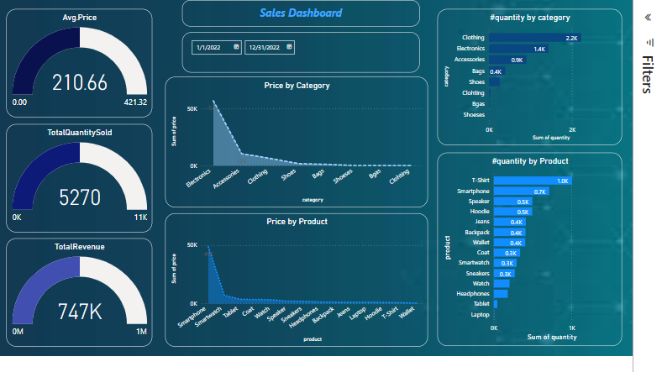
Analysis Output Cont. Sales Dashboard

Slide 11
Analysis Output Cont.
You can check Power BI Dashboard from here:
https://github.com/MohamedBatran/-intern2grow_Tasks/blob/main/Task1/orders_Sales%20Dashboard.pbix

Slide 12



Summary
After the analysis I got the following:
Smartphones are the most revenue-generating products
Electronics are the most revenue-generating Categories
Quarter 3 Is the most revenue-generating quarters
Quarter 2 Is the lowest revenue-generating quarters
Laptops is the highest avg price and T-shirts is the lowest
Clothing category is the best-selling category
shoes category is the lowest selling category
T-shirts Product is the best-selling category
Laptops product is the lowest selling category

Slide 13




Thank you
Mohamed Batran
batranmohamed001@gmail.com

